Slide 1

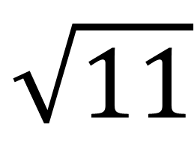


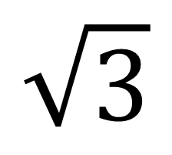

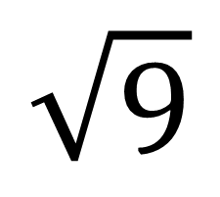


My Index, Surd & Log Interactive Notebook
$$×$$
$$\sqrt{3}$$
$$÷$$
$$+$$
$$\sqrt{11}$$
$$−$$
$$π$$
Name
Class
Teacher
Term 1 Semester 1
$$5^{2}$$
$$\sqrt{9}$$
1

Slide 2
Contents
Glossary or Formula Page
Page
Date
Description
2
3

Slide 3
Tasks
24
7
30
Essential Question
Questions
Notes
Summary
6
7

Slide 4
24
7
30
Date
Number system and surds
EQ – How do I find the $√$ of a non standard number Exactly?
7

Slide 5
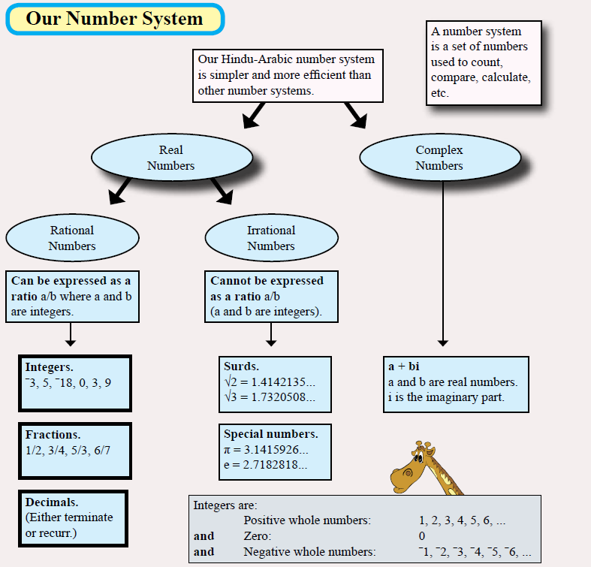
24
7
30
Date
Number system and surds
EQ – How do I find the $√$ of a non standard number Exactly?
Just as a starter lets look at our number system!
Real, unreal, rational
And irrational numbers
7

Slide 6
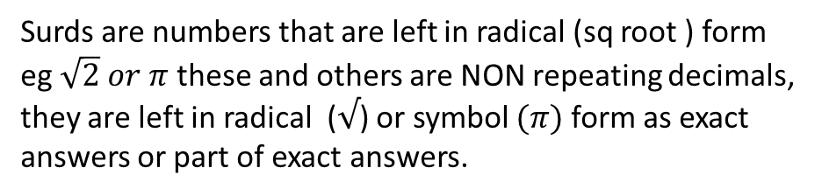
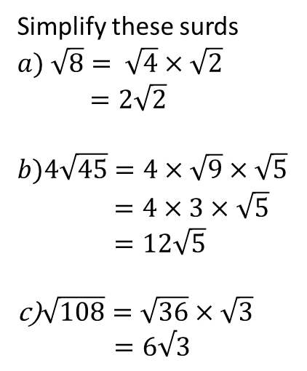
24
7
30
Date
Number system and surds
EQ – How do I find the $√$ of a non standard number Exactly?
Surds are numbers that are left in radical (sq root ) form
eg $\sqrt{2} or π$ these and others are NON repeating decimals, they are left in radical ($√$) or symbol $(π)$ form as exact answers or part of exact answers.
Real, unreal, rational
And irrational numbers
Surds
Simplify these surds
$$a) \sqrt{8}= \sqrt{4}×\sqrt{2} \\ =2\sqrt{2}$$ $$b)4\sqrt{45}=4×\sqrt{9}×\sqrt{5} \\ =4×3×\sqrt{5}$$ $=12\sqrt{5}$ c)$\sqrt{108}=\sqrt{36}×\sqrt{3}$ $$=6√3$$
These are all now exact answers, if you remember we talked a little about this last year.
7

Slide 7
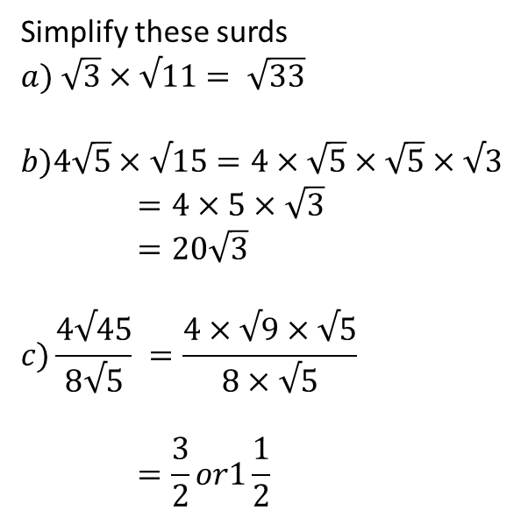
24
7
30
Date
Number system and surds
EQ – How do I find the $√$ of a non standard number Exactly?
Surds are numbers that are left in radical (sq root ) form
eg $\sqrt{2} or π$ these and others are NON repeating decimals, they are left in radical ($√$) or symbol $(π)$ form as exact answers or part of exact answers.
Real, unreal, rational
And irrational numbers
Surds
Simplify these surds
$$a) \sqrt{3}×√11= \sqrt{33}$$ $$b)4\sqrt{5}×√15=4×\sqrt{5}×\sqrt{5}×√3 \\ =4×5×\sqrt{3}$$ $=20\sqrt{3}$ $$c)\frac{4√45}{8√5} =\frac{4×√9×√5}{8×√5}$$ $$=\frac{3}{2}or1\frac{1}{2}$$
These are all now exact answers, if you remember we talked a little about this last year.
1
1
Cancel
2
1
7

Slide 8
Exercises
Exercise 4.1 and 2.2 from Dwyer
All to be done with a smile on your faces.

Slide 9
Notes Review
24, 7 ,30
Date
Title
Essential question
Notes complete
Notes complete with colour and diagrams
Questions completed
Contents page filed in
Formula page filled in

Slide 10
Homework
Review your notes and write a summary answering the essential question.

